Slide 2
Automating Network Tasks with Cisco NX-OS Device-Level APIs
Alexander Stevenson, Developer Advocate @alexstev_dev
DEVWKS-2037

Slide 3

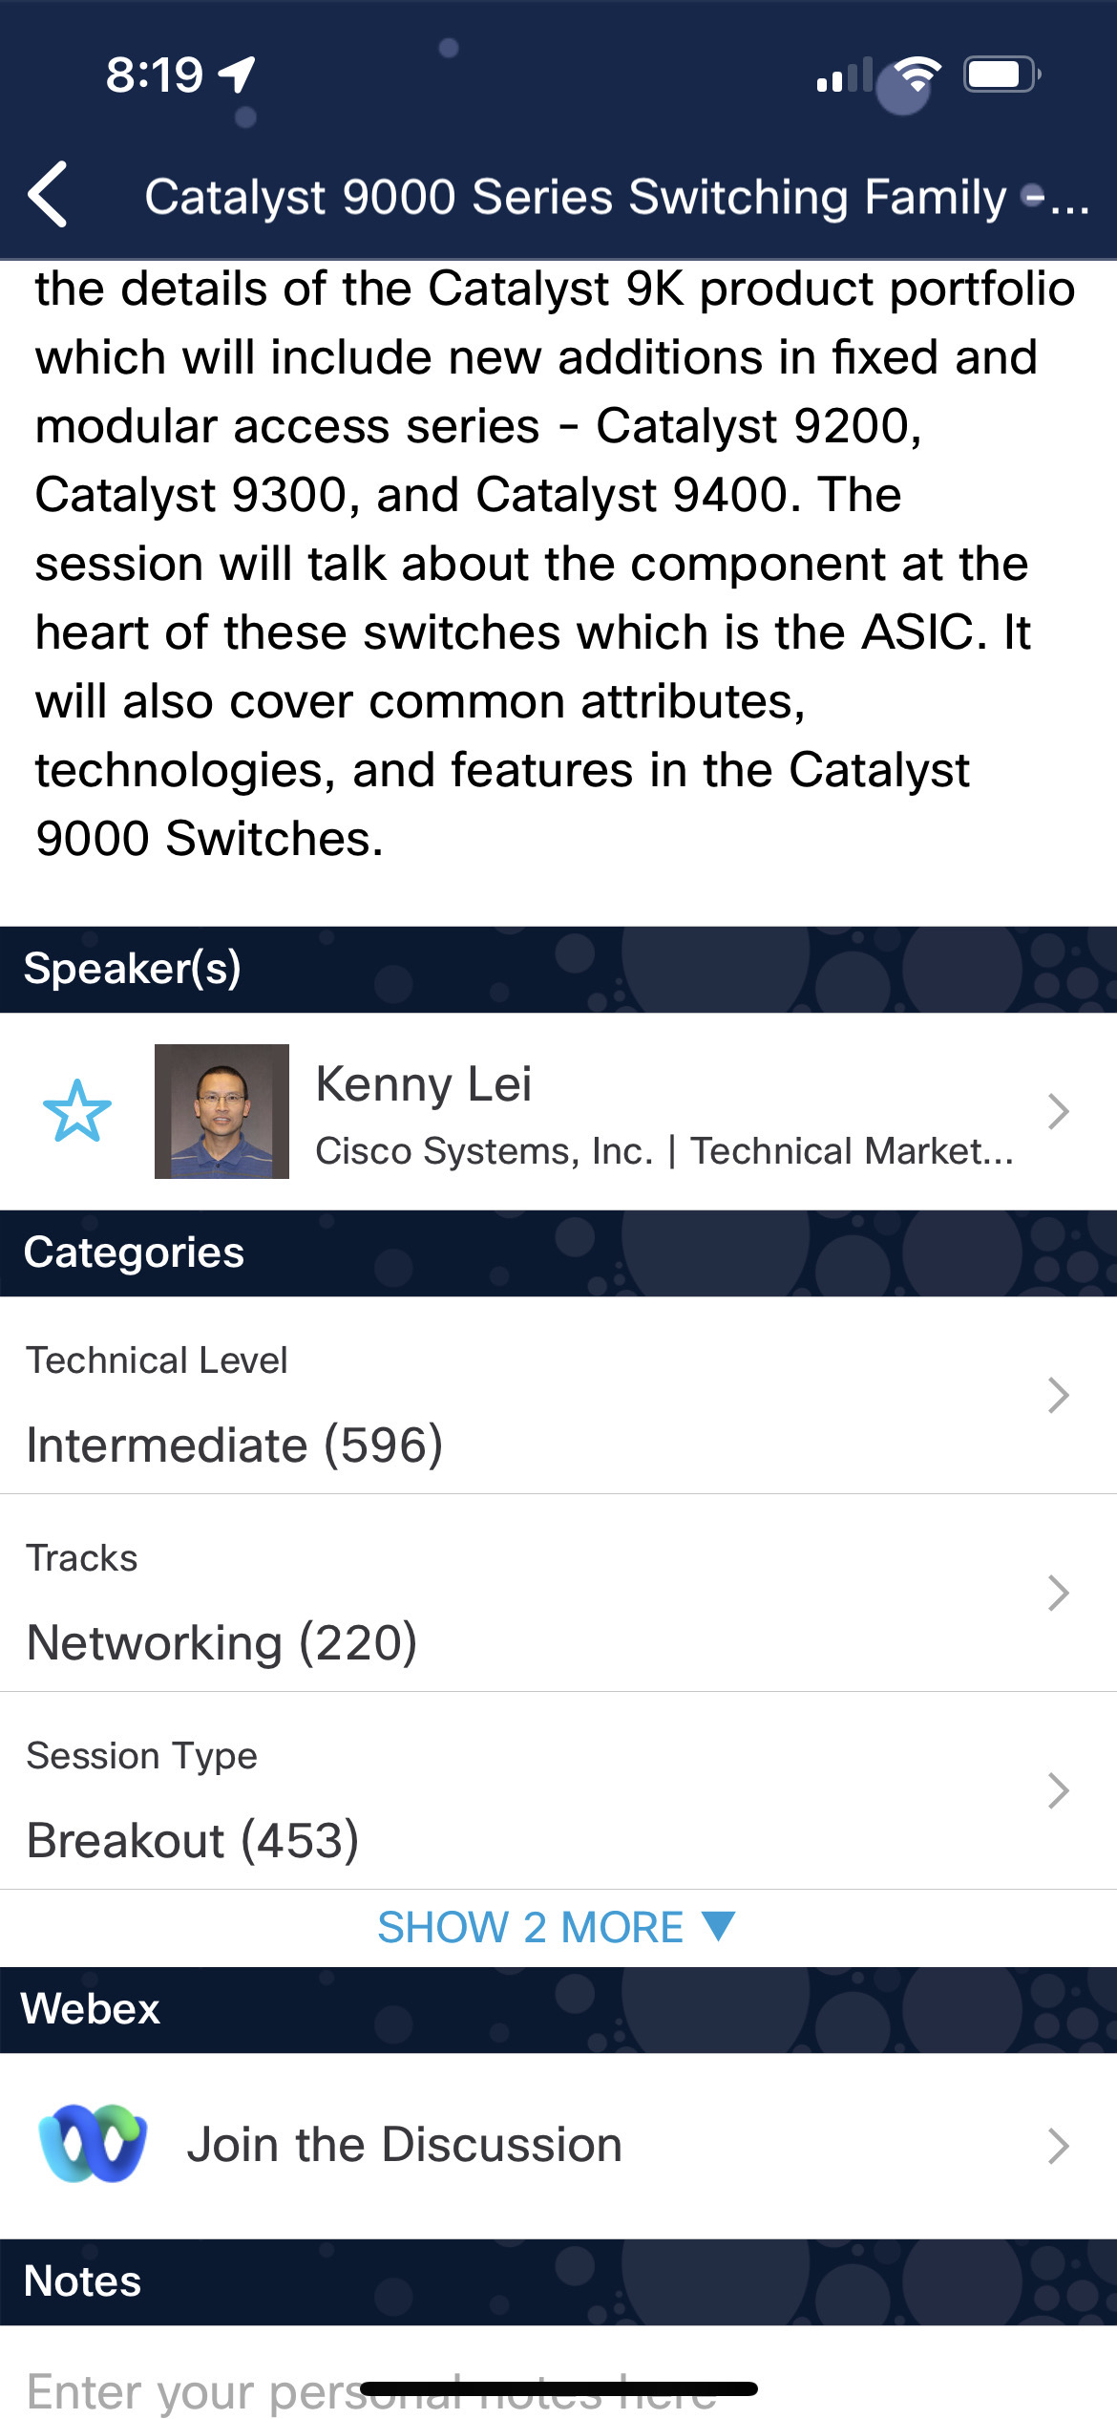
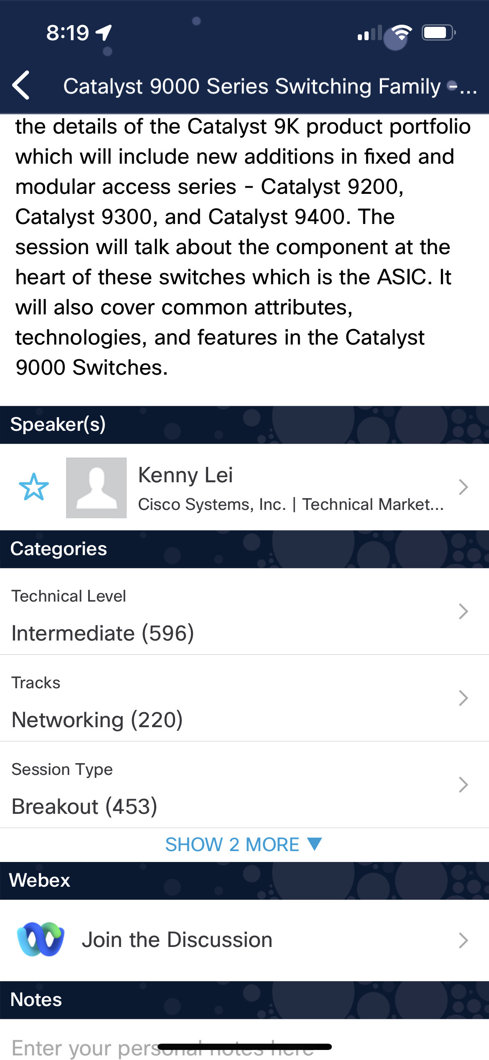

Cisco Webex App
https://ciscolive.ciscoevents.com/ ciscolivebot/#BRKXXX-xxxx
Questions? Use Cisco Webex App to chat with the speaker after the session
How
1
Find this session in the Cisco Live Mobile App
Click “Join the Discussion”
Install the Webex App or go directly to the Webex space
Enter messages/questions in the Webex space
2
3
4
Webex spaces will be moderated by the speaker until June 7, 2024.
Enter your personal notes here
© 2024 Cisco and/or its affiliates. All rights reserved. Cisco Public

Slide 4
Introduction
NX-OS overview
The Cisco NX-OS Software advantage
Industry-Leading Data Center OS
NX-OS Interfaces and Protocols
NX-CLI, NXAPI-CLI, and NXAPI-REST
NX-OS Tools to Enable Automation
NX-OS Bash, Guestshell, and NX-API Sandbox
Demo
Specially-crafted DevNet Learning Lab

Slide 5
Learn More:
DevNet Learning Labs
DevNet Sandboxes
Cisco Code Exchange
Additional Resources for NX-OS
Next-Level Programmability and Visibility
Looking forward: Next-Level Programmability and Visibility
Summary

Slide 6
Introduction

Slide 7
Speaker
Alexander Stevenson
Developer Advocate and DevNet Engineer at Cisco DevNet
A Cisco Code Exchange, Cisco Blogs, and Cisco Community published author
Co-creator and lead content developer of the ‘DevOps Shop’ video series
Certifications: DevNet Specialist – DevOps, DevNet Associate, and Cisco Certified Cyber Ops Associate

Slide 8

Speaker
(continued)
Alexander Stevenson
Over 4 years at Cisco, previously a software engineer at Apple
Earned M.Ed, B.Sc. in Network Systems, and Diploma in Full-Stack Software Engineering
Proud cat custodian

Slide 9
Overview of NX-OS

Slide 10
The Cisco NX-OS Software advantage
Cisco NX-OS Software is an extensible, open, and programmable network operating system, the fulcrum of networking solutions for next-generation data centers and cloud networks.
It is the industry’s most deployed data center operating system, based on a highly resilient, Linux-based software architecture, from its very foundation built to enable the most performance-demanding cloud environments. Cisco NX-OS runs on Cisco Nexus data center and storage networking switches.

Slide 11
Cisco NX-OS: Industry-Leading Data Center Operating System
- Highly available - Architectural flexibility - Simplify network operations with Network modeling - Closed-loop automation - Gain end-to-end visibility - Build high-performance networks for AI/ML

Slide 12
NX-OS Interfaces and Protocols

Slide 13
NX-CLI (Nexus Command-Line Interface)
NX-CLI refers to the traditional command-line interface on Cisco Nexus switches.
It is the primary method network administrators use to configure and manage Cisco Nexus devices interactively.
Commands are entered manually through a console or SSH session.

Slide 14
NXAPI-CLI (Nexus API Command-Line Interface)
NXAPI-CLI is an interface that allows you to send CLI commands to a Cisco Nexus switch over HTTP/HTTPS.
Essentially, it lets you programmatically execute CLI commands using web-based APIs.
This is useful for automation scripts and tools that can remotely push CLI commands without needing an interactive session.
NXAPI-CLI responses are typically returned in structured formats such as JSON or XML, making it easier to parse and handle programmatically.

Slide 15
NXAPI-REST (Nexus API Representational State Transfer)
NXAPI-REST is a RESTful API that provides a more modern and standardized way to interact with Cisco Nexus switches.
Unlike NXAPI-CLI, which wraps CLI commands, NXAPI-REST uses HTTP methods (GET, POST, PUT, DELETE) to interact with network resources as objects via URI paths.
This interface allows for CRUD (Create, Read, Update, Delete) operations on switch resources, which are represented in a structured format like JSON or XML.
NXAPI-REST is typically more suitable for integration with modern applications and orchestration tools that are designed to work with RESTful APIs.

Slide 16
Summary of Interfaces and Protocols
NX-CLI is the manual interface used for direct interaction with the switch
NXAPI-CLI allows you to automate CLI commands over HTTP/S
NXAPI-REST provides a RESTful API for a higher level of structured and programmable interaction with network resources on Nexus switches. Each of these interfaces serves different use cases depending on the level of automation and integration required.

Slide 17
NX-OS Tools to Enable Automation

Slide 18
NX-OS Bash: A Bash shell provided by the NX-OS for advanced on-device scripting and troubleshooting. It does not directly tie into NX-CLI, NXAPI-CLI, or NXAPI-REST, but you can use it to execute NX-CLI commands or automate tasks on the device.
Guest shell: A virtualized Linux environment running on the switch that allows users to run scripts and applications in an isolated space. You can use this environment to interact with NX-OS using any of the available interfaces (NX-CLI, NXAPI-CLI, and NXAPI-REST).
NX-API Sandbox: A built-in feature of NX-OS that provides an interactive web-based interface to help developers learn and experiment with the NXAPI-CLI and NXAPI-REST. It is a tool for testing and debugging API calls and does not provide direct NX-CLI command execution.

Slide 19


Feature | NX-CLI | NXAPI-CLI | NXAPI-REST | Description
NX-OS Bash |  |  |  | Bash shell access in NX-OS for low-level system interaction. Can be used alongside NX-CLI for system management tasks.
Guestshell |  |  |  | A secure, Linux-based environment where Python and other scripts can be run independent of NX-OS. Useful for automation that can interact with any of the interfaces (NX-CLI, NXAPI-CLI, NXAPI-REST).
NX-API Sandbox |  |  |  | An on-device tool for exploring and debugging NXAPI-CLI and NXAPI-REST. Provides a web-based interface to send commands and view responses in different formats.

Slide 20
Demo: Learning Lab

Slide 21

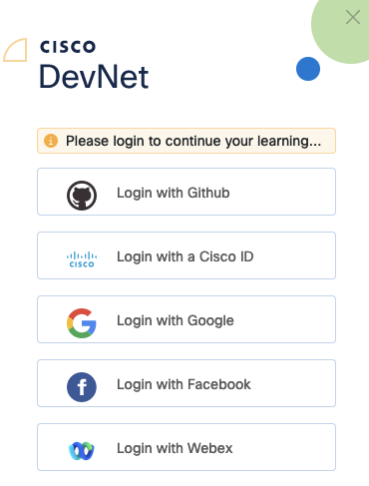
First Steps
Navigate to https://developer.cisco.com/learning/labs/dne-dci-nxos-device-level-apis/
Login via one of the options presented

Slide 22
First Steps
Logins have been created for every seat in the workshop
Structure:
devnet.ws<1 or 2>.seat<number>@outlook.com
e.g. devnet.ws1.seat1@outlook.com ==> workshop1 seat 1
The password is the same for all accounts C1sco12345!

Slide 23
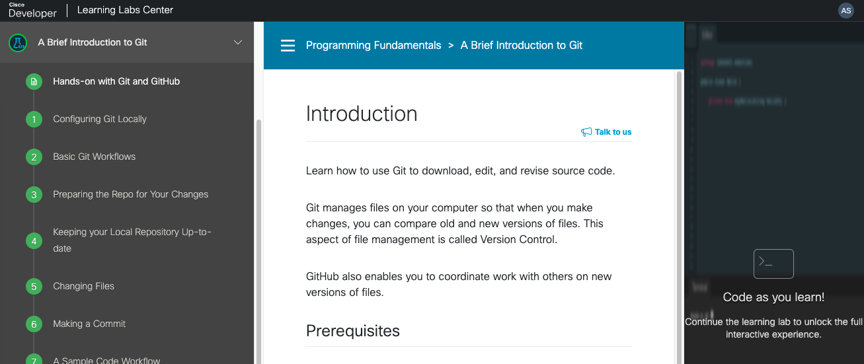
Main components of the Learning Lab environment
Table of Contents Instructions Code IDE
#CiscoLive
© 2022 Cisco and/or its affiliates. All rights reserved. Cisco Public

Slide 24
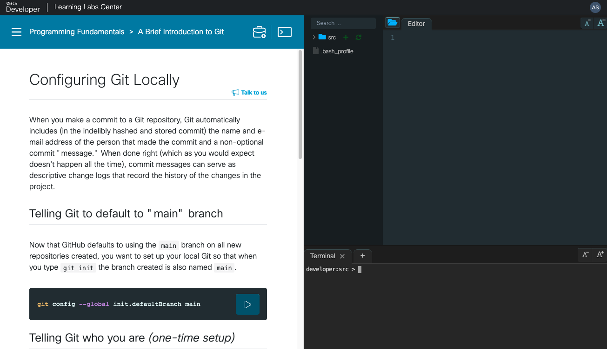
Lab walk-through File System and Editor Interactive terminal
#CiscoLive
Session ID
© 2022 Cisco and/or its affiliates. All rights reserved. Cisco Public

Slide 25
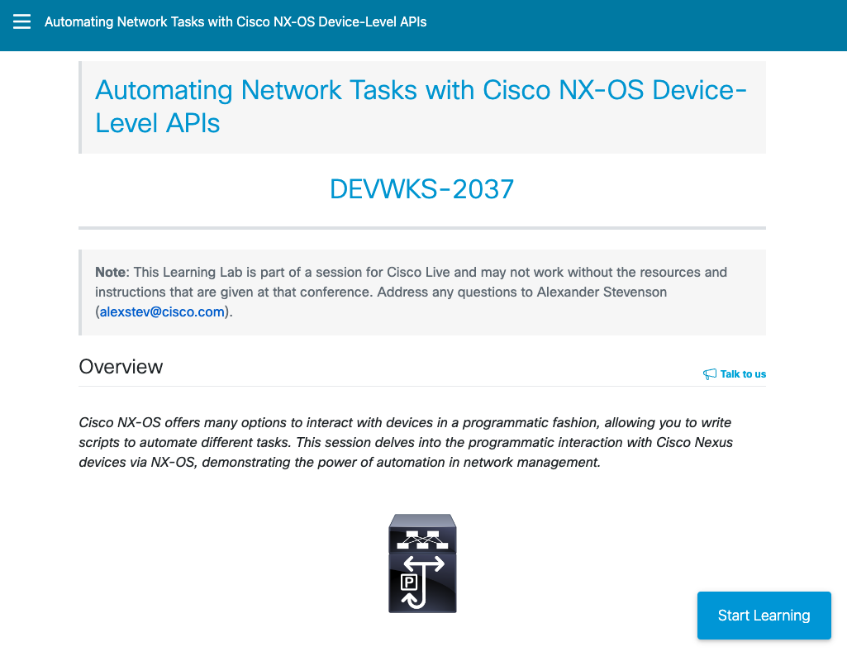
Introduction
URL:
Commands: https://github.com/xanderstevenson/nxos-device-level-apis/blob/main/Lab-Commands.rtf
#CiscoLive
Session ID
© 2022 Cisco and/or its affiliates. All rights reserved. Cisco Public

Slide 26
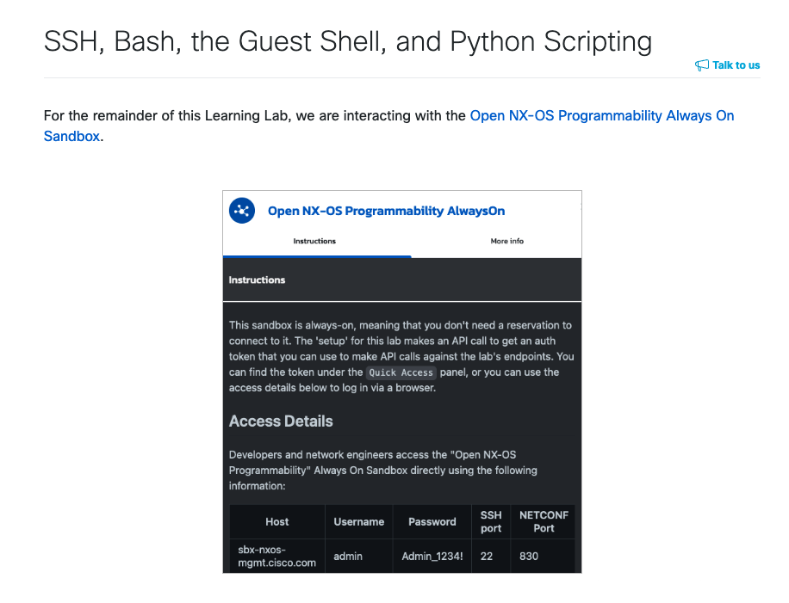
1. Crawl
#CiscoLive
Session ID
© 2022 Cisco and/or its affiliates. All rights reserved. Cisco Public

Slide 27
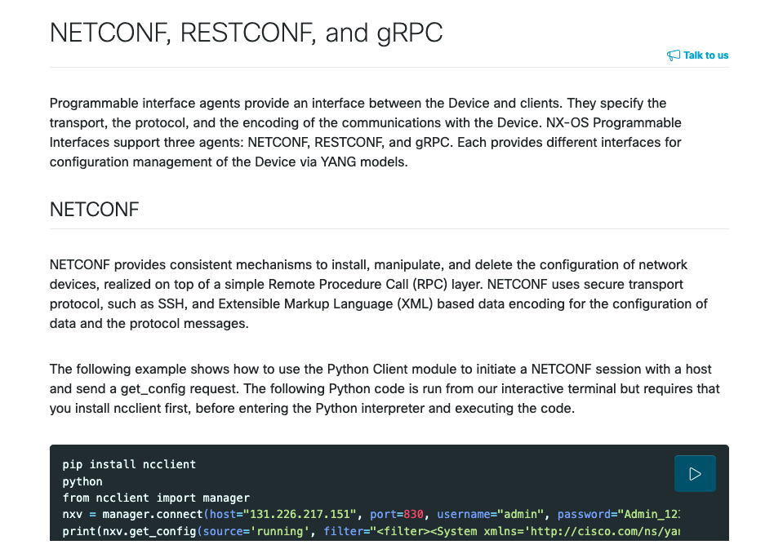
2. Walk
#CiscoLive
Session ID
© 2022 Cisco and/or its affiliates. All rights reserved. Cisco Public

Slide 28
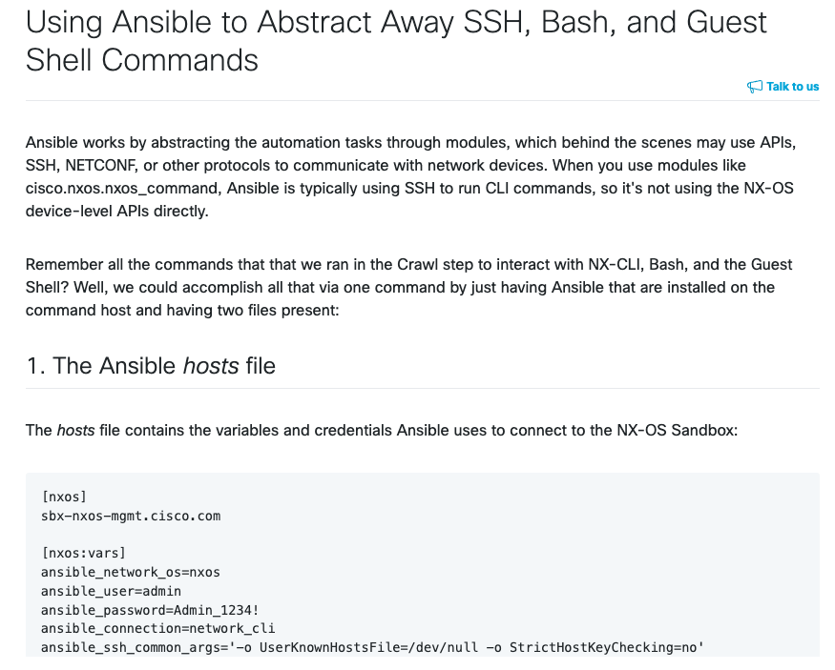
3. Jog
#CiscoLive
Session ID
© 2022 Cisco and/or its affiliates. All rights reserved. Cisco Public

Slide 29
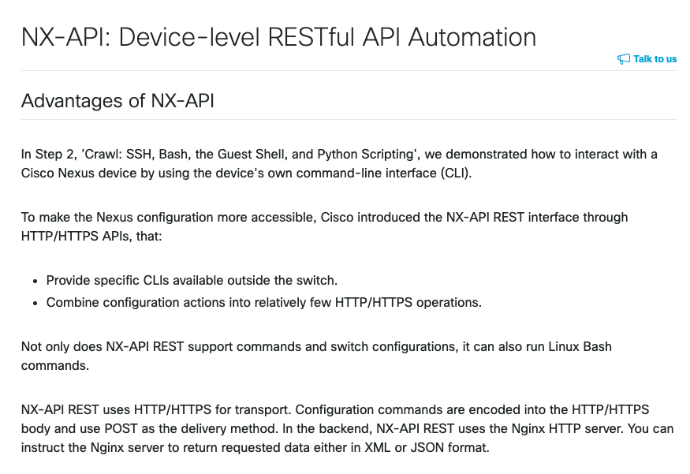
4. Run
#CiscoLive
Session ID
© 2022 Cisco and/or its affiliates. All rights reserved. Cisco Public

Slide 30
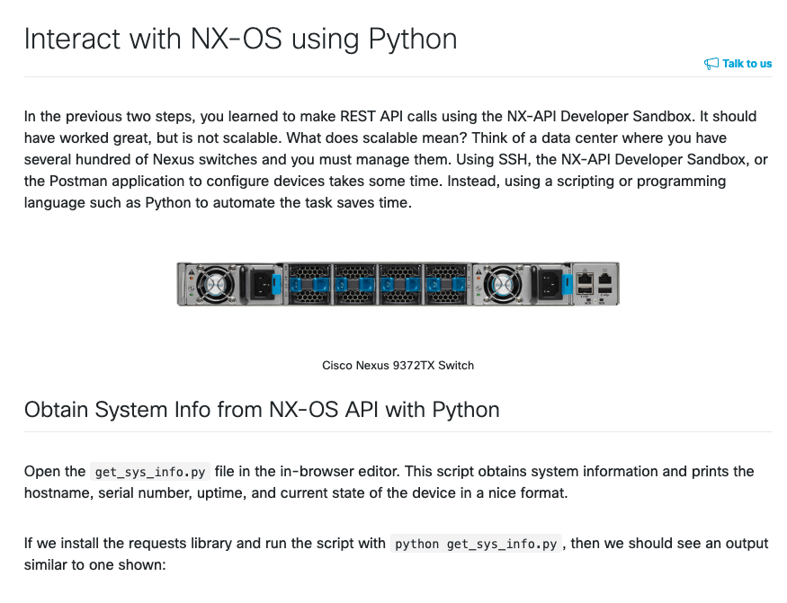
5. Fly
#CiscoLive
Session ID
© 2022 Cisco and/or its affiliates. All rights reserved. Cisco Public

Slide 31
DevNet Learning Labs

Slide 32
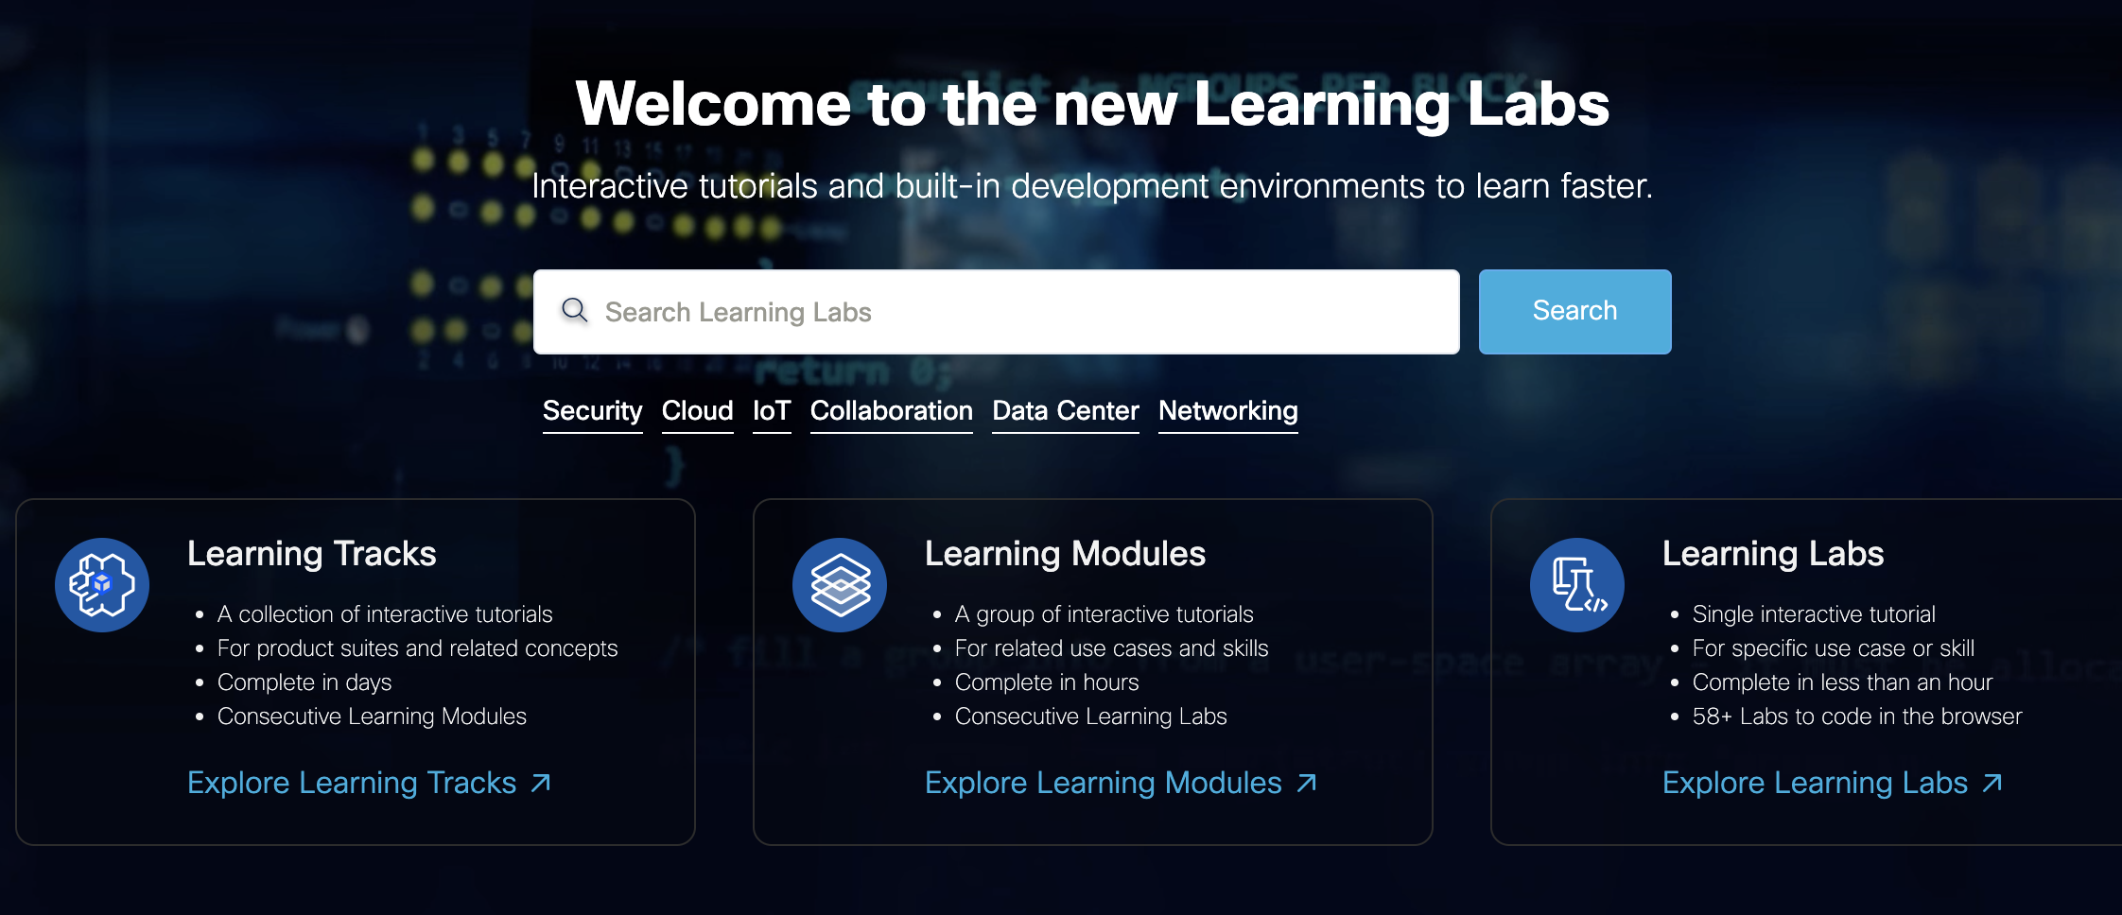
The new Learning Labs Center at https://developer.cisco.com/learning has an abundance of FREE Ansible offerings.

Slide 33
Free Ansible Learning Labs at Cisco DevNet
Learning Tracks: 26
…consist of
Learning Module: 109
…consist of
Learning Labs: 334
developer.cisco.com/learning

Slide 34
At the present time, by just searching for “Ansible”, we can find an abundance of learning tracks, modules, and labs, such as:
Introduction to NX-OS Programmability
Nexus OS Programmability and Automation
Introduction to NX-API
Investigate NX-API Options and the NX-OS Object Model
And more….

Slide 35
DevNet Sandboxes

Slide 36
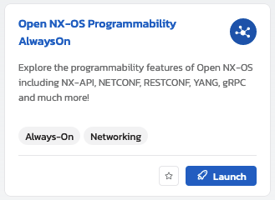
Attention IT professionals! Make sure to make use of the FREE DevNet sandboxes at https://devnetsandbox.cisco.com/
The Open NX-OS Programmability Always-On sandbox we used for our Demo is found at:
https://devnetsandbox.cisco.com/DevNet/catalog/Open-NX-OS-Programmability

Slide 37
Cisco Code Exchange

Slide 38
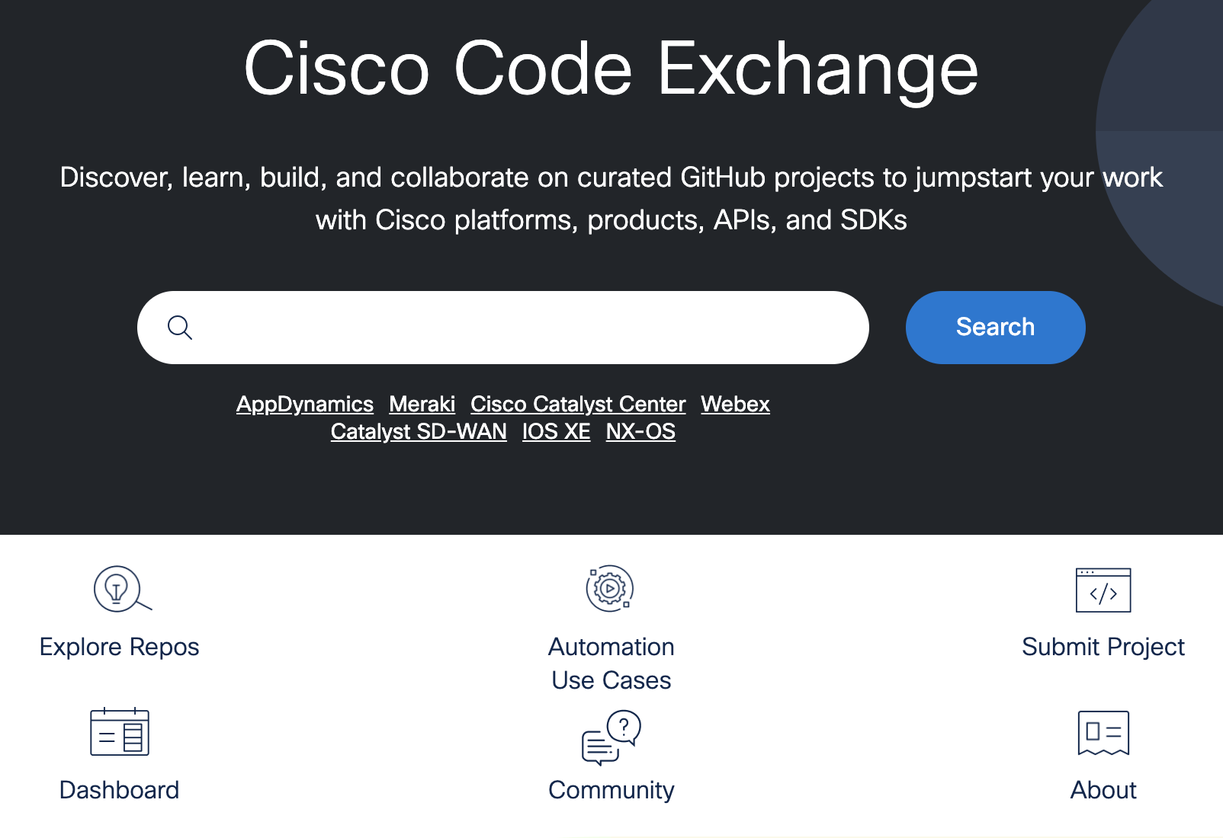
Cisco Code Exchange is the place to discover code repositories related to Cisco technologies: https://developer.cisco.com/codeexchange/
There are currently 116 repos and counting there written for NX-OS, created with languages and technologies such as Python, Shell, Smarty, C++, Go, Ruby, Ansible, JavaScript, HTML, Jinja, HCL, and Docker.
https://developer.cisco.com/codeexchange/search/?order=products&products=NX-OS

Slide 39
Additional Resources for NX-OS

Slide 40
Cisco NX-OS Resources – Official NX-OS resources found on Cisco.com
sbx_nxos_ao - Sample Code, Scripts and Information for use in DevNet’s Always-On Open NX-OS Sandbox
nxos-code - Code Samples for Open NX-OS Learning Labs
NX-SDK - a simple, flexible, and powerful tool for off-the-box 3rd party custom Application development and Do-it-Yourself Automation
Programming with NX-API Lessons - NX-API Part 1: Get Started with APIs and Nexus and NX-API Part 2: Dive into the Nexus Object Model
ansible-network/cisco_nxos - This role provides a set of platform dependent functions that are designed to work with NX-OS network devices.
terraform-provider-nxos - Terraform Provider for NX-OS
nxos-netbox-sync - Demonstration of how to keep your NX-OS switch configuration aligned with a Netbox Source of Truth

Slide 41

Next-Level Programmability and Visibility
#CiscoLive
© 2022 Cisco and/or its affiliates. All rights reserved. Cisco Public

Slide 42
Extensive programmability: • Day-zero automation through Power On Auto Provisioning, drastically reducing provisioning time • Industry-leading integrations for leading DevOps configuration-management applications, including Ansible, Chef, Puppet, and SaltStack • Extensive Native YANG and industry-standard OpenConfig model support through RESTCONF/NETCONF and gRPC

Slide 43
Extensive programmability: • Pervasive APIs for all-switch CLI functions with NX-API (JSON-based RPC over HTTP/HTTPs) • Comprehensive software development kit for custom Cisco NX-OS applications with NX-SDK on Python, Go, and C++ • Modular and secure application integration architecture, with support for Secure LXC and Docker application hosting options natively in Cisco NX-OS

Slide 44
Pervasive visibility: • Network-software state is exposed through a comprehensive publish/subscribe centralized database (DME) accessible through gRPC/Protobufs, http/JSON, and YANG-state streaming • Cloud-scale ASICs enable flow-state awareness and granular subsecond access to utilization metrics for microburst awareness and queue occupancy for large-scale RDMA over Converged Ethernet (RoCE) storage environments

Slide 45
Pervasive visibility: • Advanced buffer monitoring reports real-time buffer use per port and per queue, which allows organizations to monitor traffic bursts and application traffic patterns • Network traffic monitoring with Cisco Nexus® Data Broker builds simple, scalable, and cost-effective network Test Access Points (TAPs) and Cisco® Switched Port Analyzer (SPAN) aggregation for network traffic monitoring and analysis

Slide 46
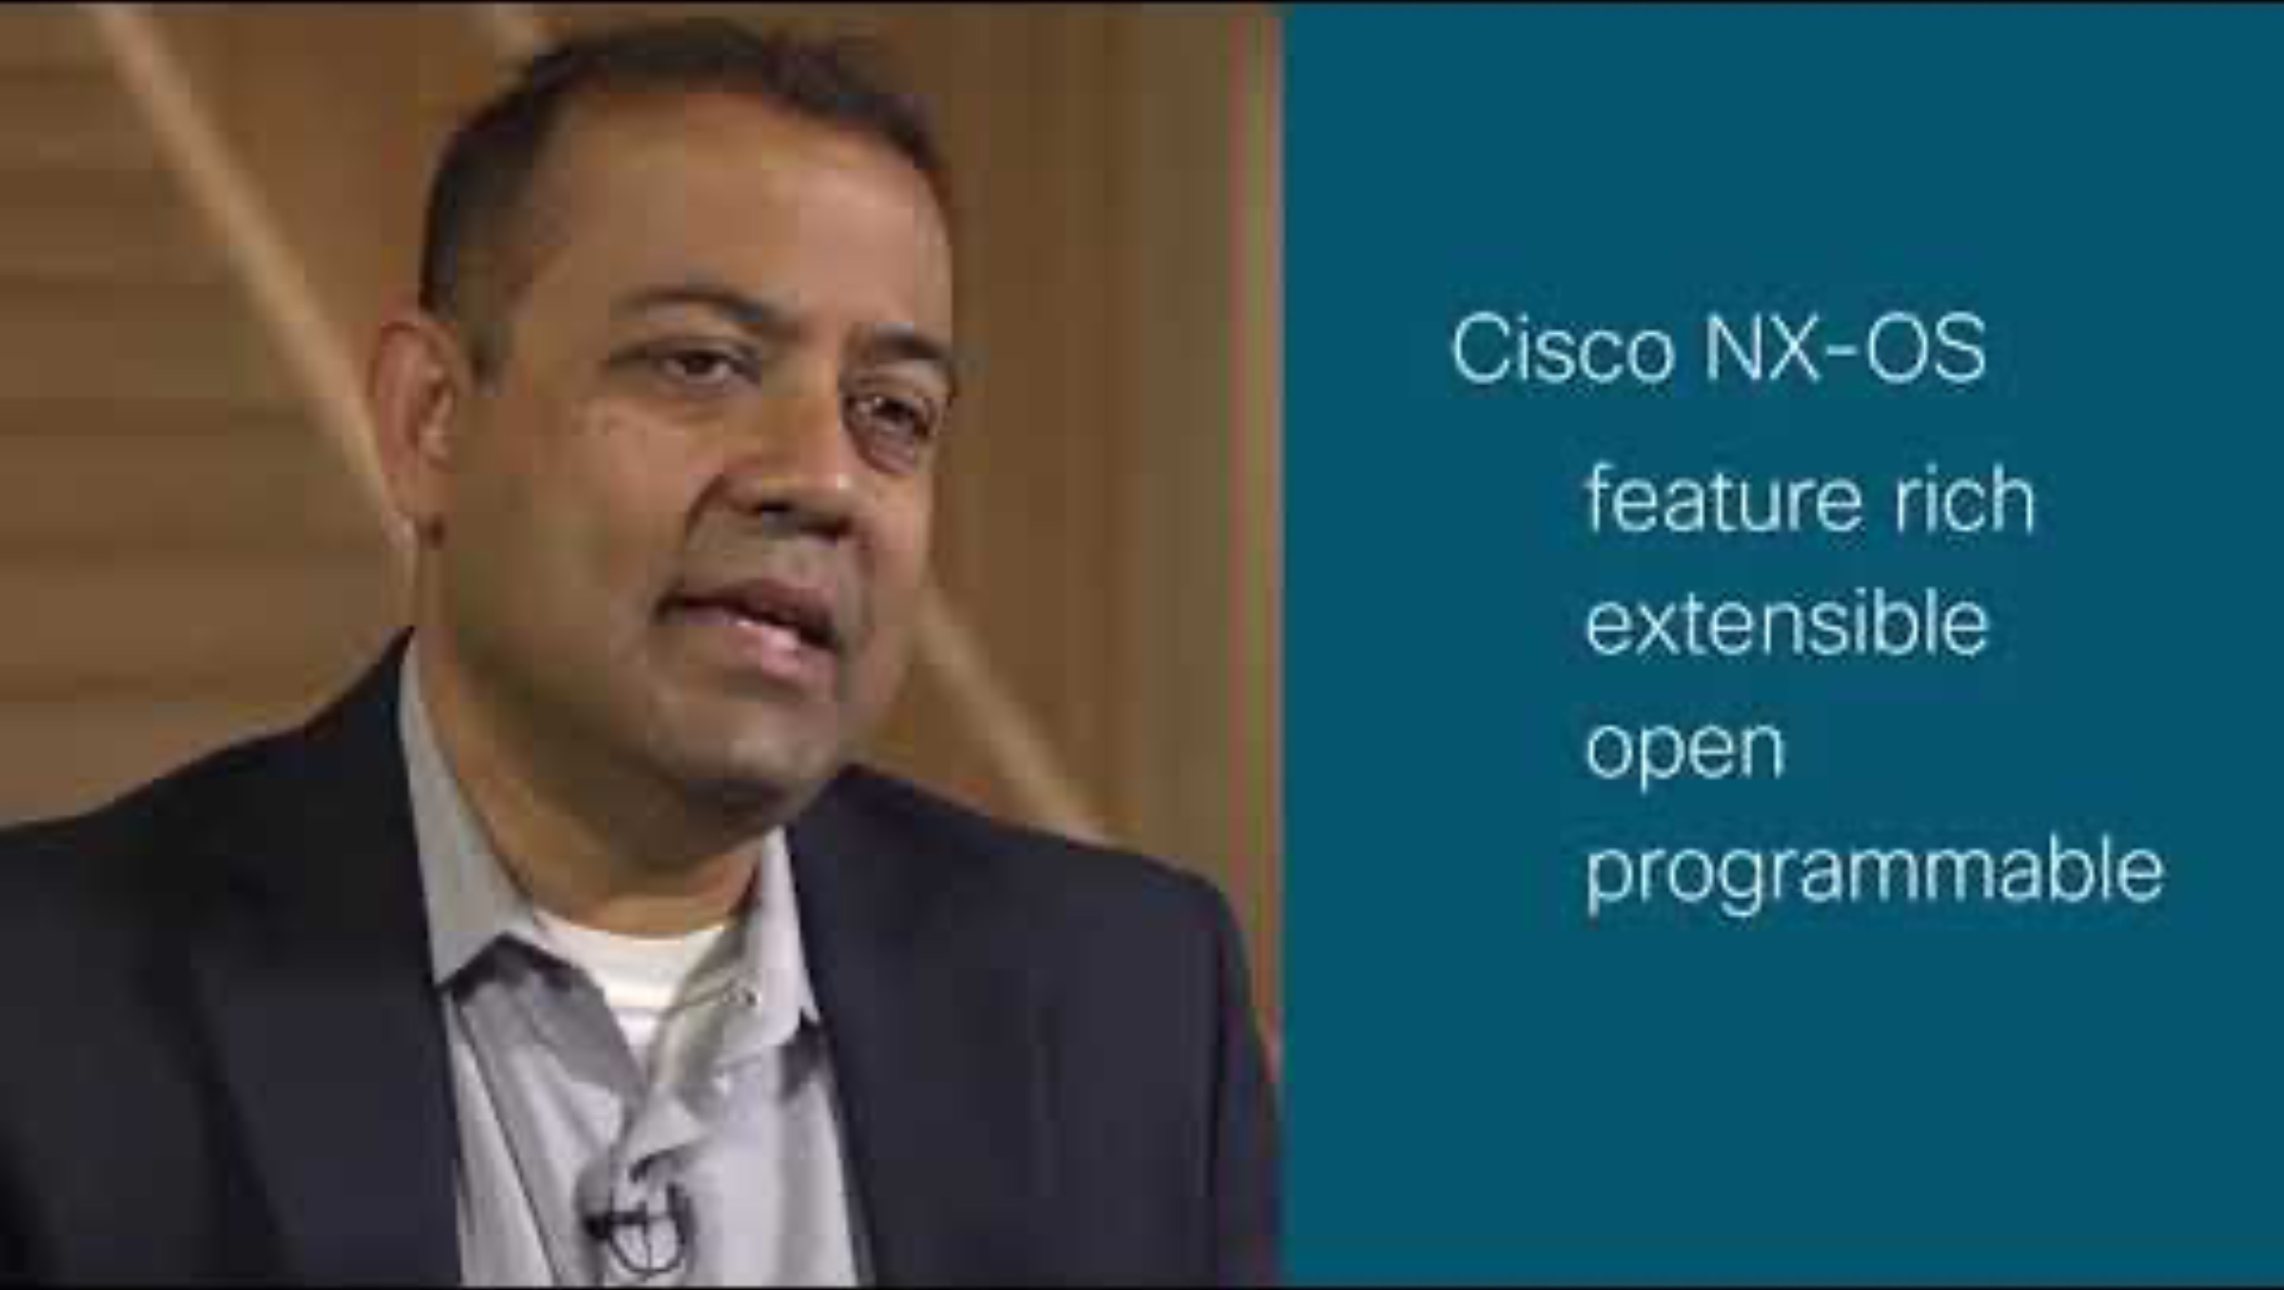

Slide 47
Summary
Cisco NX-OS offers the advantage of the Industry-Leading Data Center Operating System.
NX-OS offers a choice of Interfaces and Protocols: NX-CLI, NXAPI-CLI, NXAPI-REST
NX-OS offers Tools to Enable Automation: NX-OS Bash, Guest Shell, NX-API Sandbox

Slide 48
What We’ve Learned Today…
Demo
Specially-crafted DevNet Learning Lab
Learn More:
DevNet Learning Labs
DevNet Sandboxes
Cisco Code Exchange
Additional Resources for NX-OS
Looking forward: Next-Level Programmability and Visibility

Slide 49
Looking forward…
Soon the question may not be be whether a human interacts with a device via CLI , Ansible, or other tool, but how humans can drive AI to program intent via human-readable prompts, and let the ‘machines’ figure out which models, schemas and CLI commands produce the desired intent.
- Mark Culverhouse, Principle Architect
Cisco Systems

Slide 50
Fill out your Session Surveys!
#CiscoLive
© 2022 Cisco and/or its affiliates. All rights reserved. Cisco Public

Slide 51
Continue your education
Visit the Cisco Showcase for related demos
Book your one-on-one Meet the Engineer meeting
Attend the interactive education with DevNet, Capture the Flag, and Walk-in Labs
Visit the On-Demand Library for more sessions at www.CiscoLive.com/on-demand
Contact me at: alexstev@cisco.com

